Slide 1
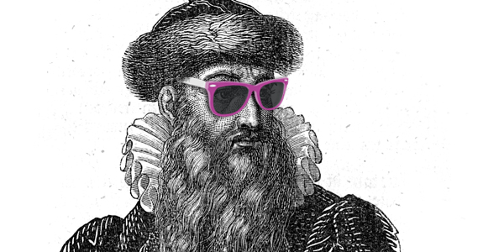
Seek and They Will Find
Improving Discoverability for Online Resources
Robena Barton
Technical Services Librarian
Oconee County Public Library
rbarton@oconeesc.com

Slide 2
Who’s seeking what
AND IS “DISCOVERABILITY” EVEN A REAL WORD?
Notes:
Patrons are seekers of information. Discoverability refers to online resources and how easy they are to search and find what you need from them. This is especially important for Public Libraries that do not have the opportunity to train patrons on how to use their system. Making information and resources accessible from the OPAC search box is therefore highly desirable. Further, I became a “Seeker” as I attempted to seek out MARC records and make them accessible from the catalog.

Slide 3
The email that started it all:
Subject: Gutenberg Project MARC records available
From: Dana Pearson dbpearsonmlis@GMAIL.COM
Reply-To: AUTOCAT <AUTOCAT@LISTSERV.SYR.EDU>, Dana Pearsondbpearsonmlis@GMAIL.COM
Date: Sun, 14 Dec 2014 20:38:40 -0600
Apologies for cross postings...anyone that knows how to get the message out to public libraries, do forward
The Gutenberg Project has it roots in the early 70's and is an example of a big idea that started small.
http://www.gutenberg.org/wiki/Gutenberg: The_History_and_Philosophy_of_Project_Gutenberg_by_Michael_Hart
Many libraries have added this content into their library systems. Most have been able to do so because they have the necessary programming expertise on staff. Since most libraries do not, I decided to crosswalk the available RDF/Dublin Core metadata into MARC21.
I uploaded the MARC records to the Internet Archive in 2013 and have just uploaded records for content added since the original harvest.
The files have been grouped according to content type to facilitate library handling and selection. There are two versions, UTF-8 and MARC-8.
see my webpage: http://dbpearsonmlis.com/GP_MARC_2013.html
Notes:
The Gutenberg project is a massive collection of public domain works that are freely available online. We currently have around half the collection added in as MARC records for our system.

Slide 4
First, figure out how to use MARCedit
SECOND, FIGURE OUT HOW TO BATCH LOAD A .MRC FILE
Notes:
MARCedit has been a lifesaver as I batch edited .MRC files containing thousands of records so that I could identify them later for further edits or deletions. Batch loading has helped me later on as we added vendors that provided .MRC files of their own such as Overdrive and TEI audio.

Slide 5

Success!
Click Here!
Notes:
Check out Emma by Jane Austen. Select the contributor to see the full collection of Project Gutenberg titles.

Slide 6

Why not
DISCUS?!?!

Slide 7
The idea grows
AFTER ATTENDING A TRAINING WORKSHOP I FIND OUT THAT, INDEED, I CAN ADD MARC RECORDS FOR DISCUS RESOURCES INTO OUR ILS.

Slide 8
Things get Sticky
Each database is provided by a different vendor
Each vendor has a different way of handling MARC records
Contacting vendors can be frustrating
Records maintenance continues to be a headache.

Slide 9

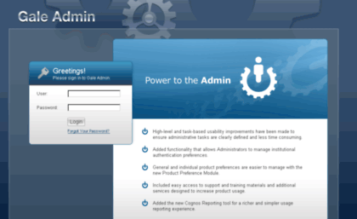
Some Examples…..
Requires username, password, and complicated identification number.
Not accessible from DISCUS. You need the URL for the admin portal. From there you need a username and password. After that you can request the records and someone from support will get back to you. Eventually.

Slide 10
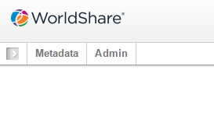
EBSCO
First, get an OCLC account
Second, configure settings in Worldshare Manager
Third, wait for OCLC to upload your files
Fourth, download your batch
Fifth, wait for OCLC to upload again because you messed up a setting and the files don’t work
Sixth, check back monthly for updates and delete or modify as necessary

Slide 11
Restrictions May APPLY
USAGE
ACCESS
Notes:
Record links do not count Usage for Statistic numbers for most DISCUS databases. The exception seems to be FOF databases since BIC and OVIC records appear to count Usage. Access may also be restricted either to account holders for Learning Express resources, or by asking for DISCUS credentials with a password and/or DISCUS username depending on the database being accessed.

Slide 12


Slide 13
Despite it’s limitations, adding these resources to the catalog improves access, which makes our patrons happy!
CLICK HERE!
Notes:
Try searching for Mary Shelley.

Slide 14

It’s about Integration
Making our integrated library system as seamless as possible. Not a collection of resources from many different access points, but one catalog search to find any of them.
Click Here!
Notes:
Try searching GED. Then check out the Mango link at the bottom of the record for Fodor’s Germany to see how we are making all aspects of the catalog more integrated by improving access to more of our resources.

Slide 15
Final Thoughts:
ADDED TO THE VALUE AND EASE OF USE FOR ONLINE RESOURCES
SET-UP AND MAINTENANCE CAN BE A CHALLENGE
MAY NOT TRACK USAGE
OFF-SITE ACCESS MAY HAVE ADDITIONAL RESTRICTIONS
OVERALL IT WAS WORTH THE WORK AND I AM PLEASED WITH THE RESULT.
THINKING OF TRYING IT? START HERE: HTTP://WWW.SCDISCUS.ORG/TECHNICAL-INFORMATION
Notes:
Also see attachments for more help.

Slide 16
Questions?
Robena Barton
Technical Services Librarian
Oconee County Public Library
Walhalla, SC 29691
864- 364- 5702
rbarton@oconeesc.com

